Slide 1
Build x : android
Lecture Two: Events, Intents and the Activity Lifecycle
Handout:
https://tinyurl.com/android-lecture2-handout

Slide 2
Recap

Slide 3
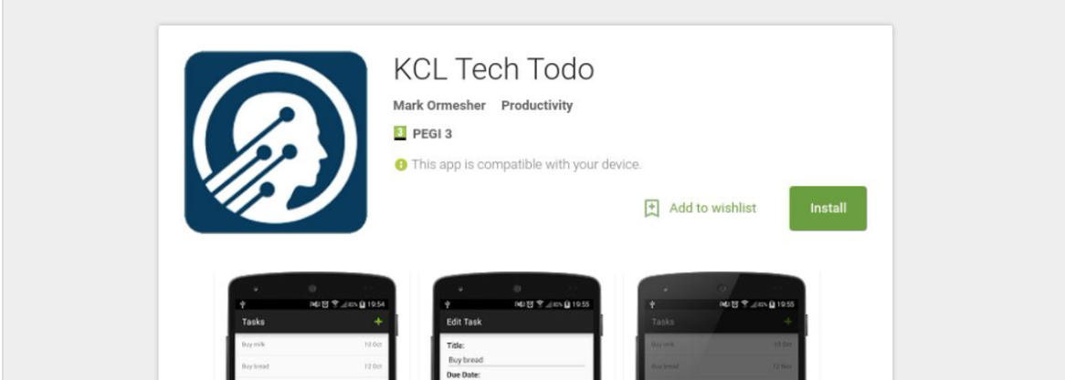
Recap – What are we doing?
We’re going to build a basic todo list app, KCL Tech Todo.
If you want a preview, it is available on Google Play.
Search for ”KCL Tech Todo” on Google or on the Play Store.

Slide 4
Recap – Layouts, Views and View Groups
Layout: a specific type of application resource
These define the structure and appearance of parts of your app
View: an individual component of a layout
A button, input field, text field, image, etc.
View Group: a special type of View that can contain other views
You can’t see the view group, but you can see the views inside of it
LinearLayout, ScrollView, RelativeLayout, etc.
Other Resources: used to supplement a layout, amongst other things
Strings, styles, dimensions, etc.

Slide 5
View Events/Actions
Handout:
https://tinyurl.com/android-lecture2-handout

Slide 6
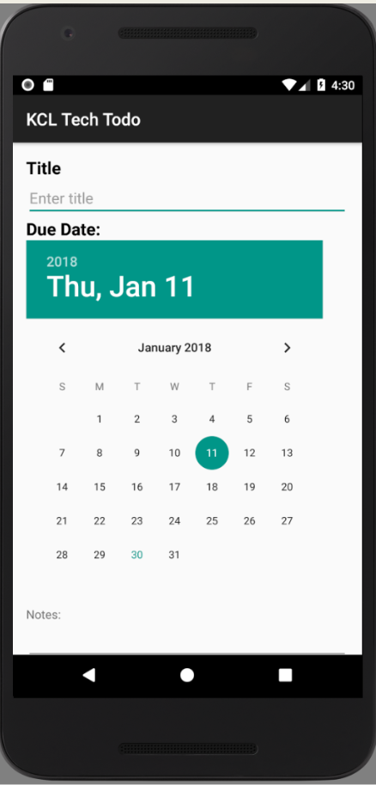
Events
We have Views…
but they don’t really do anything.
Most Views exist for users to interact
with.
We need to listen for actions on a View.
But first we need a way to refer to them in our
Java code...
How?

Slide 7
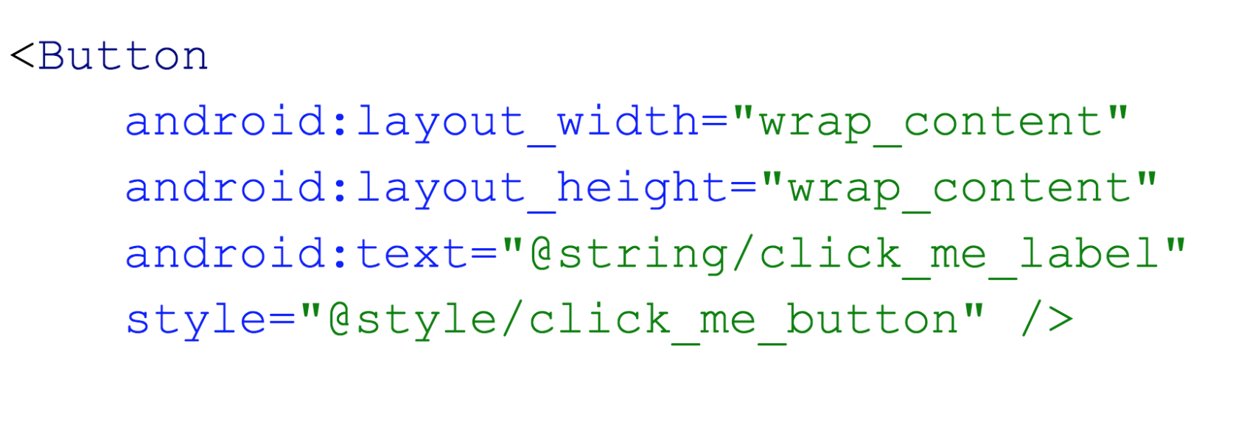
Events – Giving a View an ID

Slide 8
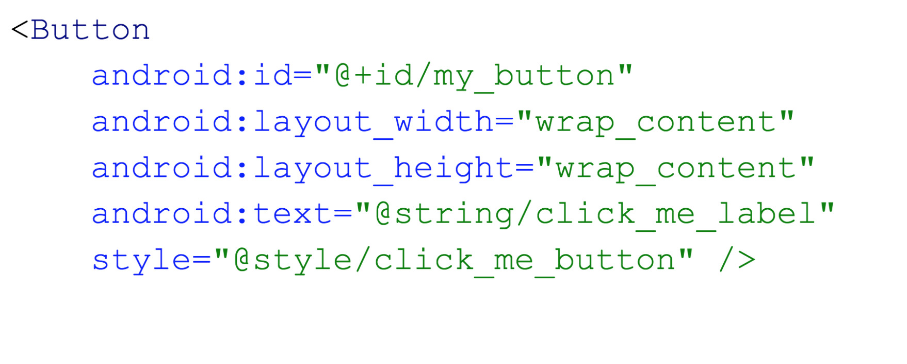
Events – Giving a View an ID

Slide 9
What’s in a name?
android:id=“@+id/my_button”
android:id(
@
+
id
my_button
We’re setting the id
of this view.
We want a
resource…
…we’re
making a
new one…
…we’re creating
an ID…
…and this is
it’s name!

Slide 10


Slide 11
Events – Giving a View an ID

Slide 12
Events – Getting a Reference to a View
I’m making a new variable
called myButton, and it’s going
to hold a Button object.
…this is the name of the
View to look for.
Button myButton =
(Button) findViewByID(R.id.my_button);
By the way, the View you
find will be a Button
Search through the layout
and find a View for me…

Slide 13
Events – Getting a Reference to a View
Button myButton =
(Button) findViewByID(R.id.my_button);
Now how do we do the stuff?

Slide 14
Events - Listen for an Event
An event is essentially an action on a View.
For a button, the onClick event occurs when the button is clicked.
We need to listen for that event, and define a response when it happens.

Slide 15
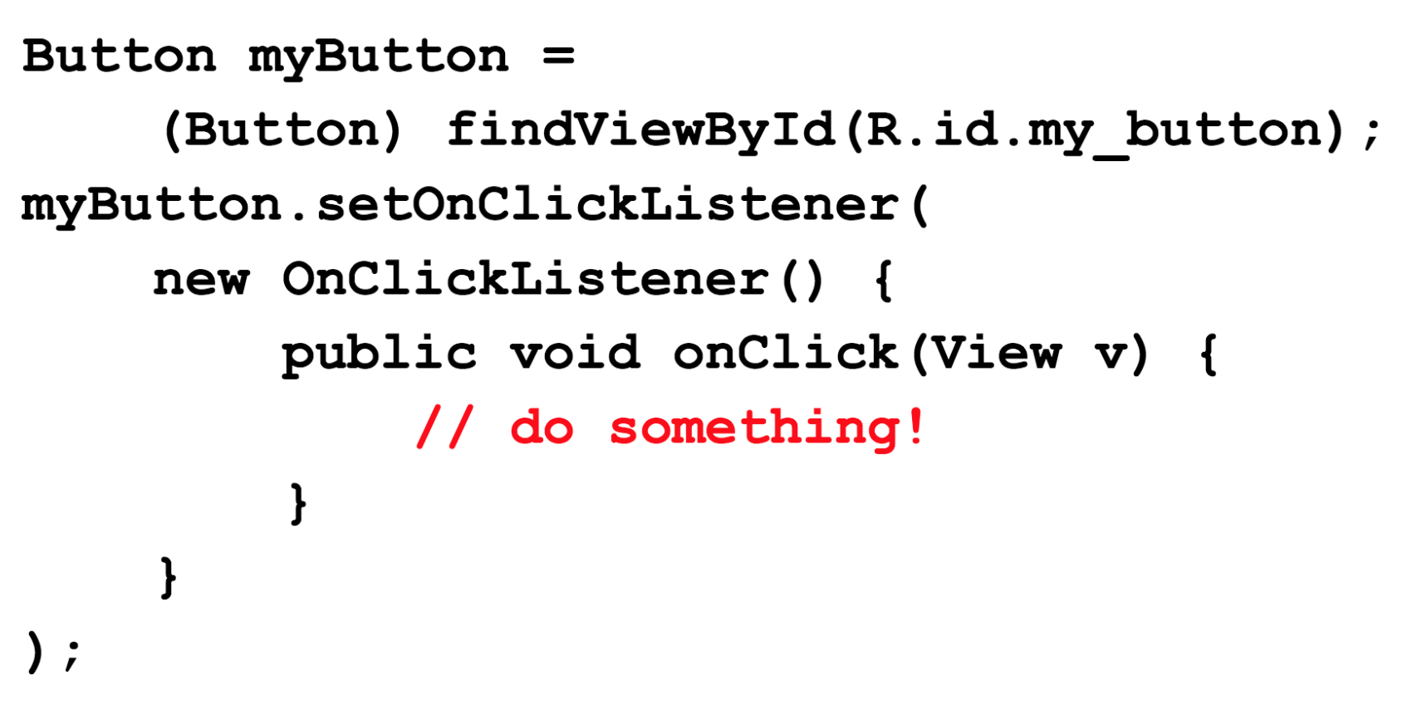

Slide 16
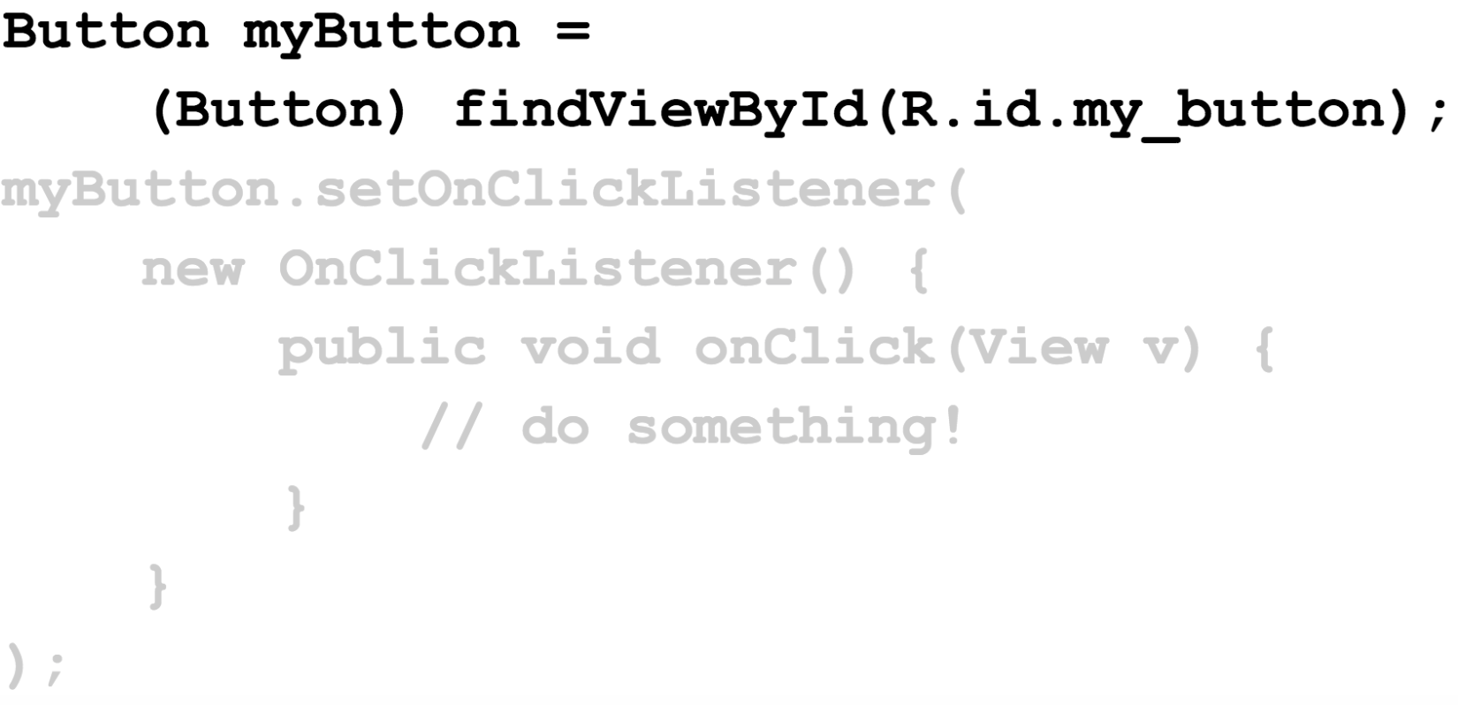

Slide 17
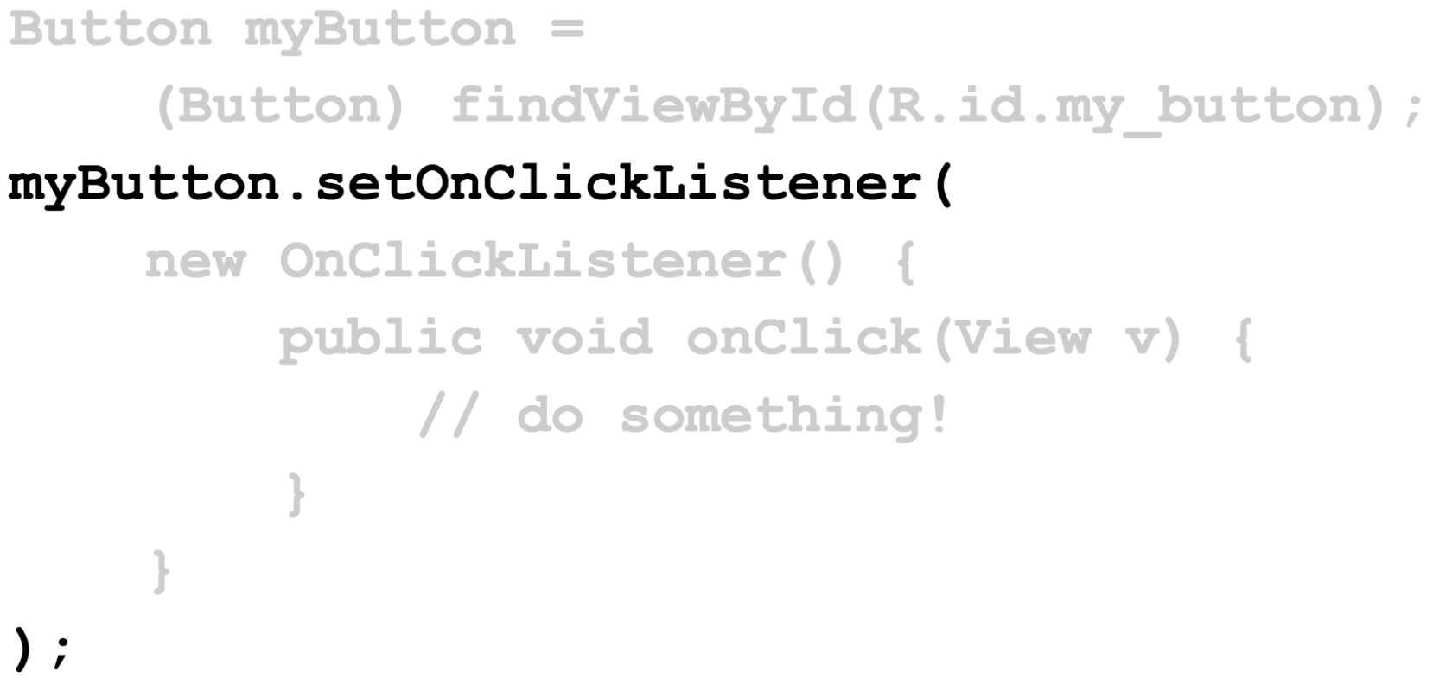

Slide 18
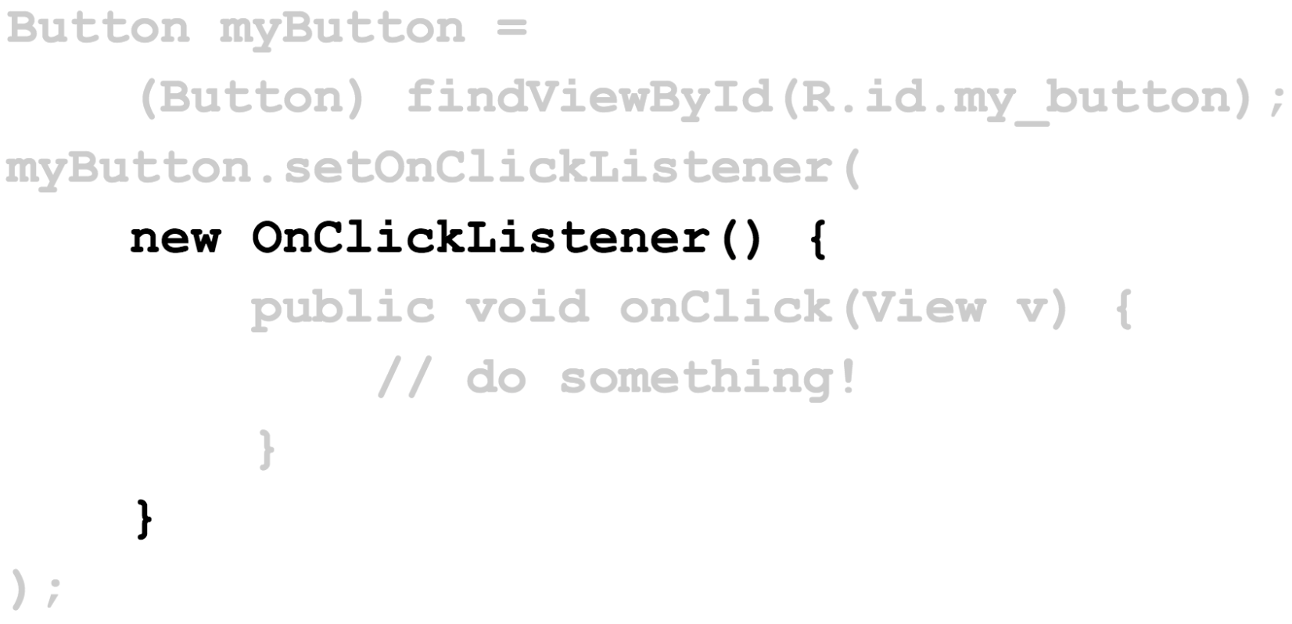

Slide 19
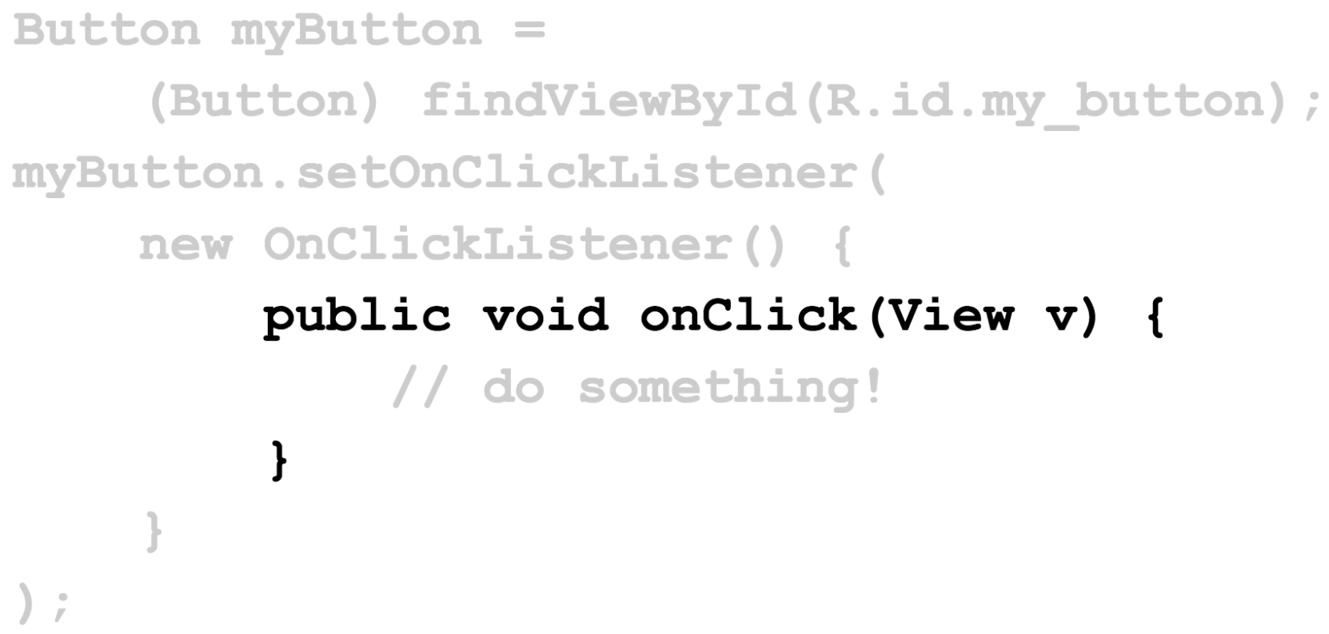

Slide 20
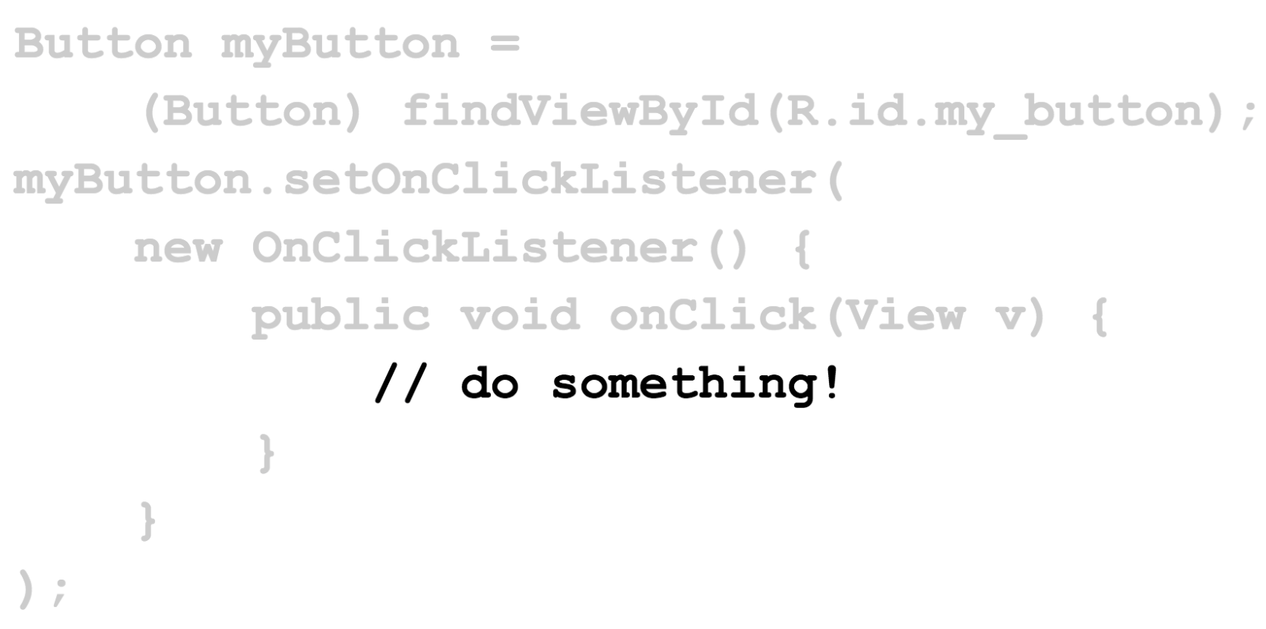

Slide 22
Coding time…

Slide 23
Events – Your Turn!
Give your button an ID, then set an onClickListener for it in the activity to make it do something.
Check the handout for some click actions you can try!
Don’t have one? Get one from here:
https://tinyurl.com/android-lecture2-handout

Slide 24
Intents

Slide 25
Intents
An intent tells Android “I intend to do something”
I intend to go to another activity
I intend to share a photo
I intend to share a message
…
I intend to do some custom action defined by my application

Slide 26
Intents – Going to a Different Activity
I’m making a new variable
called intent, and it’s going
to hold a Intent object.
Intent intent =
new Intent(CurrentActivity.this,
MyActivity.class);
Make a new Intent…
…and a target of an activity
in the class called MyActivity.
…with a context of the
current activity…

Slide 27
Intents – Going to a Different Activity
Intent intent =
new Intent(CurrentActivity.this,
MyActivity.class);
startActivity(intent);

Slide 28

Coding time…

Slide 29
Intents – Your Turn
Create a new activity, and call it what ever you like.
Use the onClick method from the last section to start an intent that takes the user to your new activity.

Slide 30
Intents – Sending Extras

Slide 31
Intents – Sending Extras
What if you wanted to send some information with the new Intent? Send extras.
An extra is a simple key/value pair, where they key is always a String and the value is any primitive type (int, string, boolean, etc.).
Adding an extra to an Intent is pretty straight forward.

Slide 32
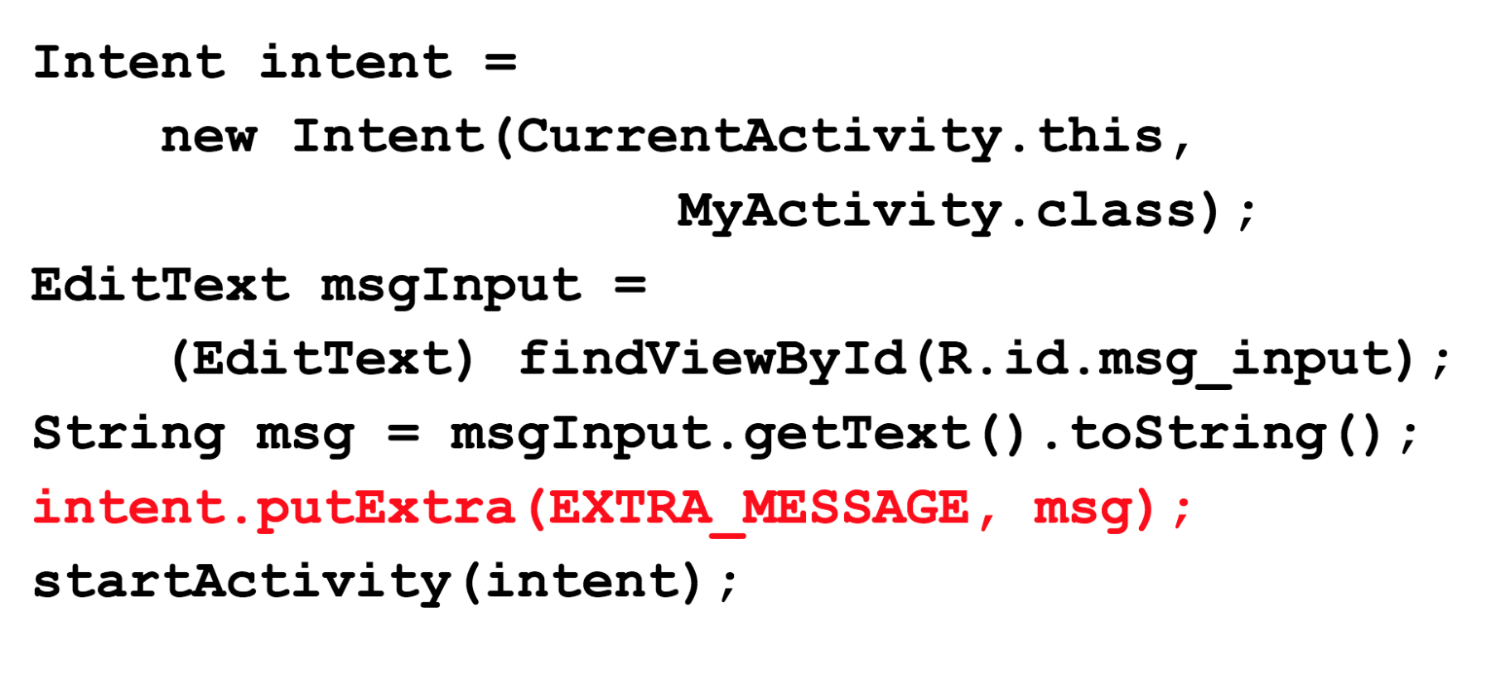

Slide 33
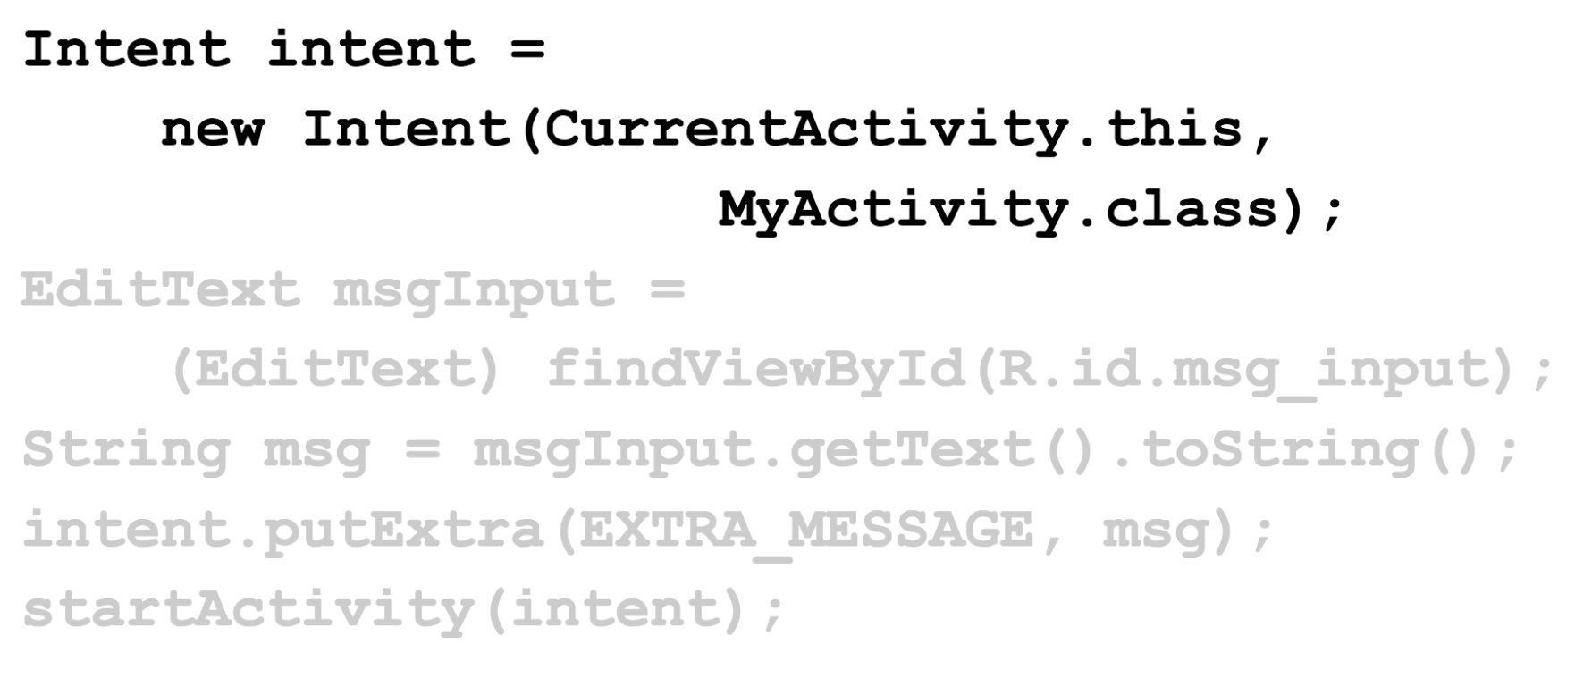

Slide 34
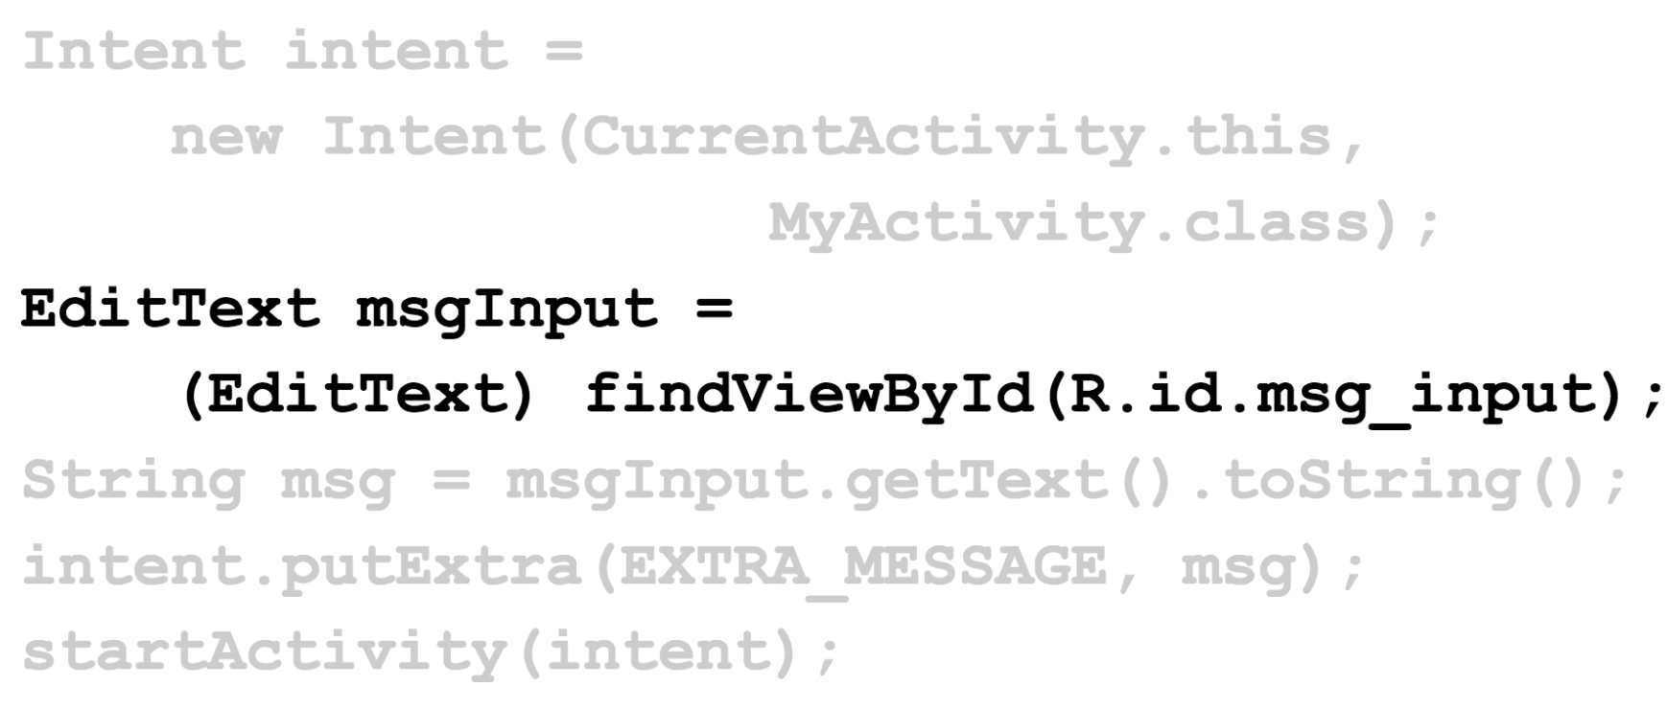

Slide 35
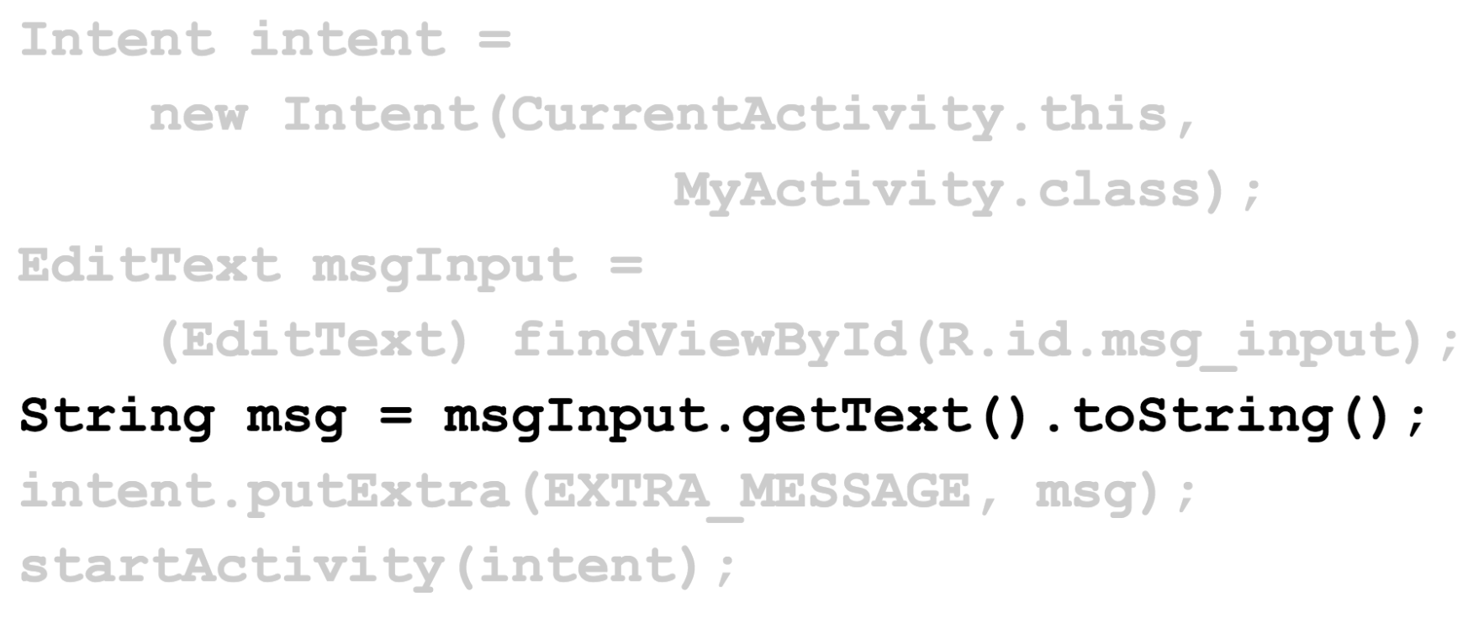

Slide 36
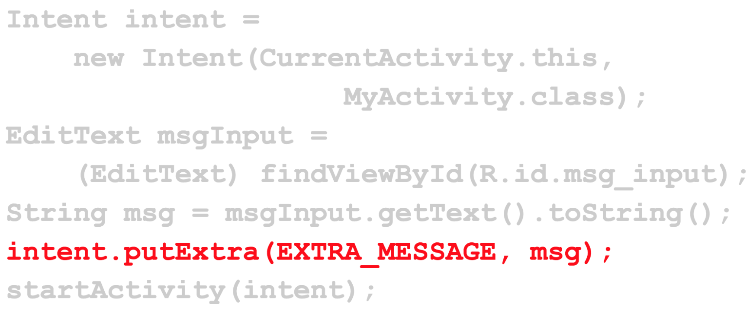

Slide 37
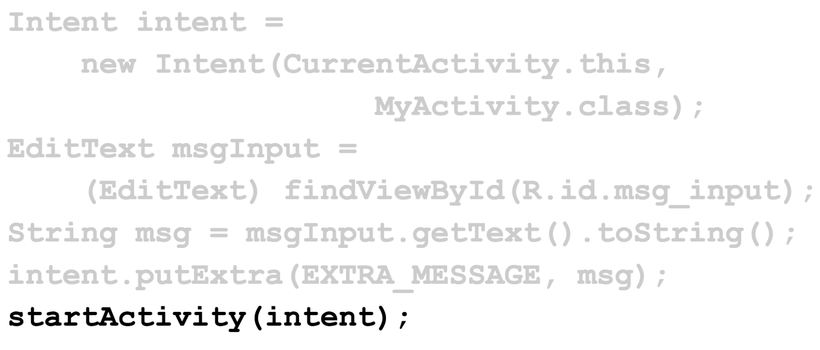

Slide 39
Intents – Reading Extras

Slide 40
Intents – Reading Extras
Every activity is launched with an intent, which you can access.
To get the Intent, call Intent intent = getIntent();
To get the extras, call Bundle extras = intent.getExtras();
A good place to call these methods is in the onCreate() method
We’ll be looking at what that is next!

Slide 41
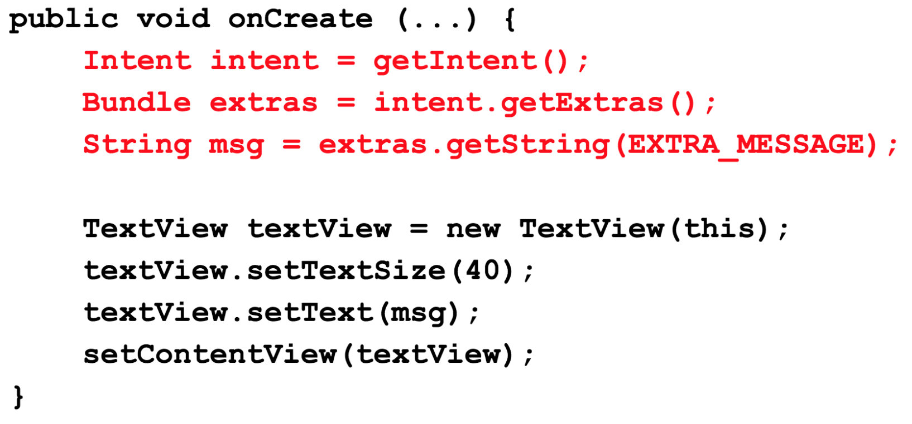

Slide 42
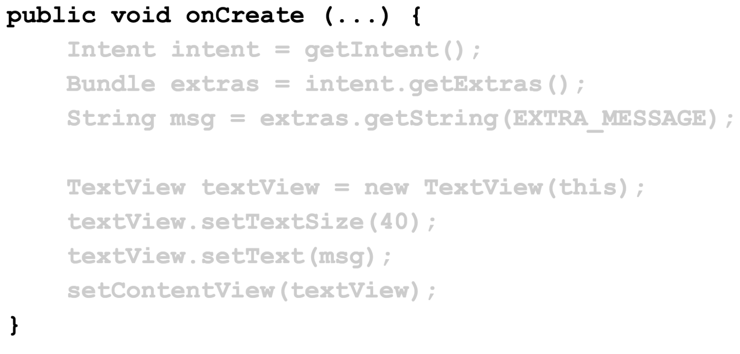

Slide 43
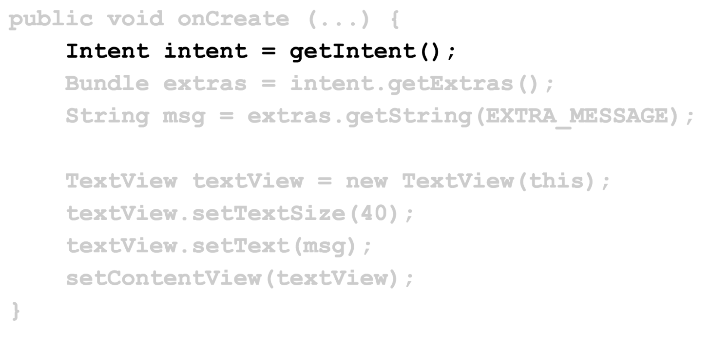

Slide 44
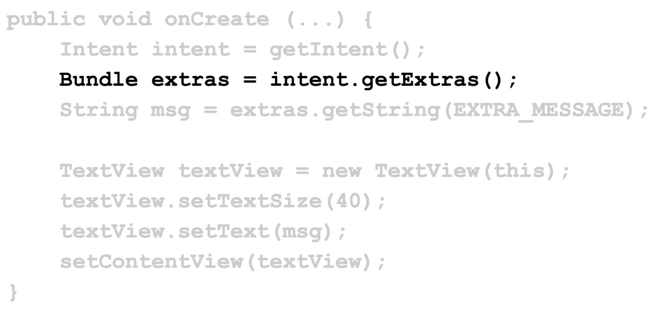

Slide 45
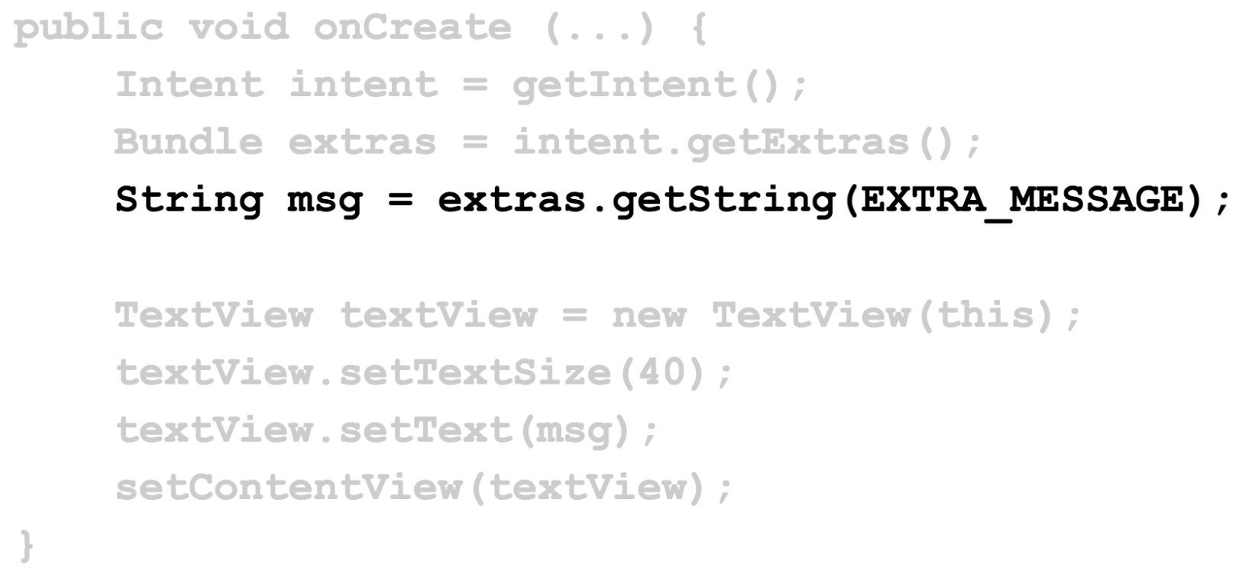

Slide 46
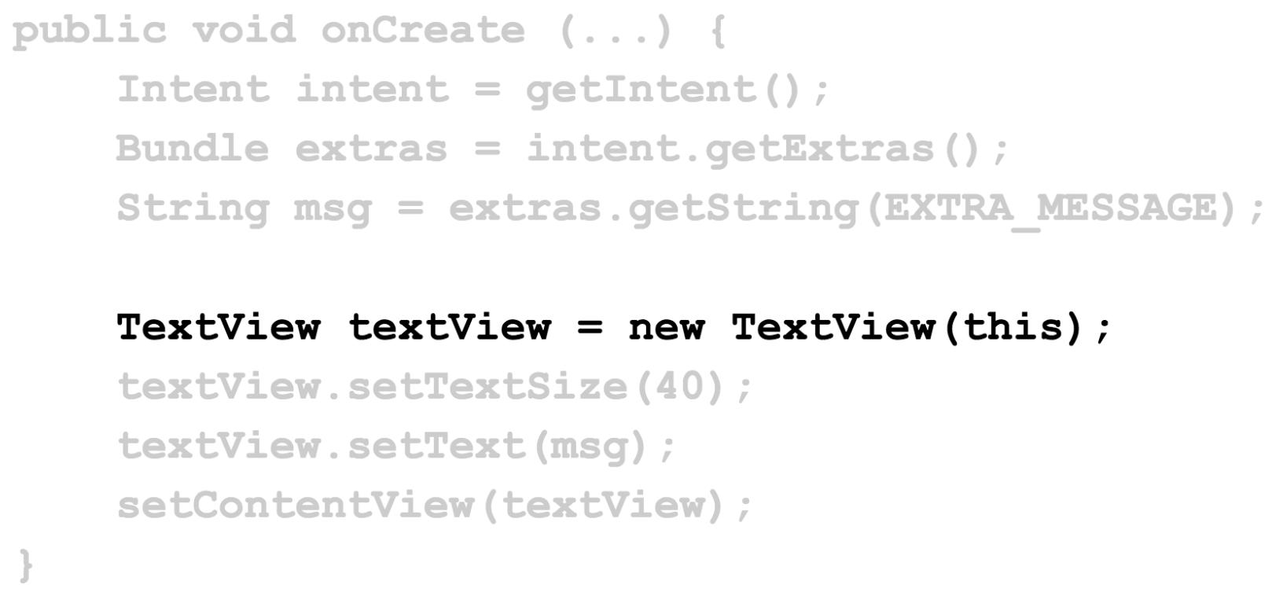

Slide 47
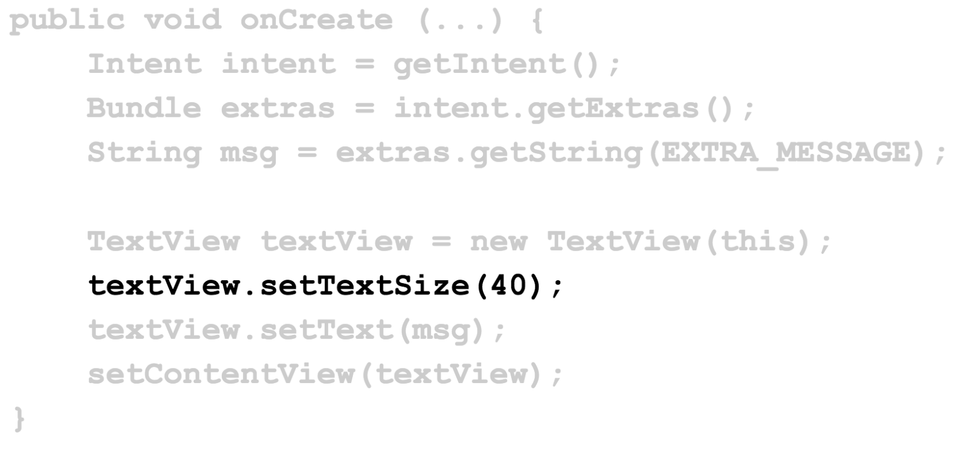

Slide 48
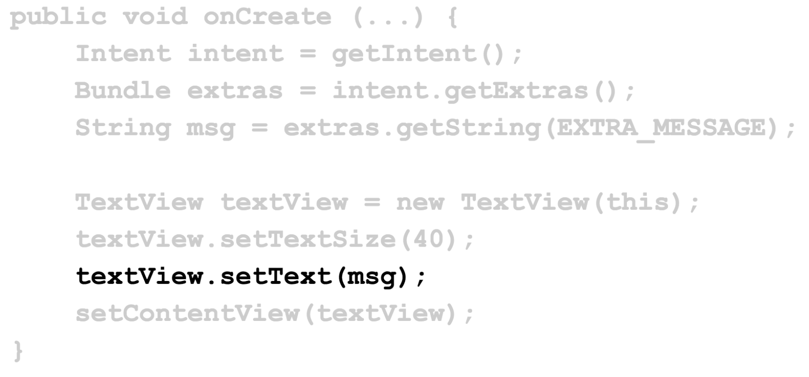

Slide 49
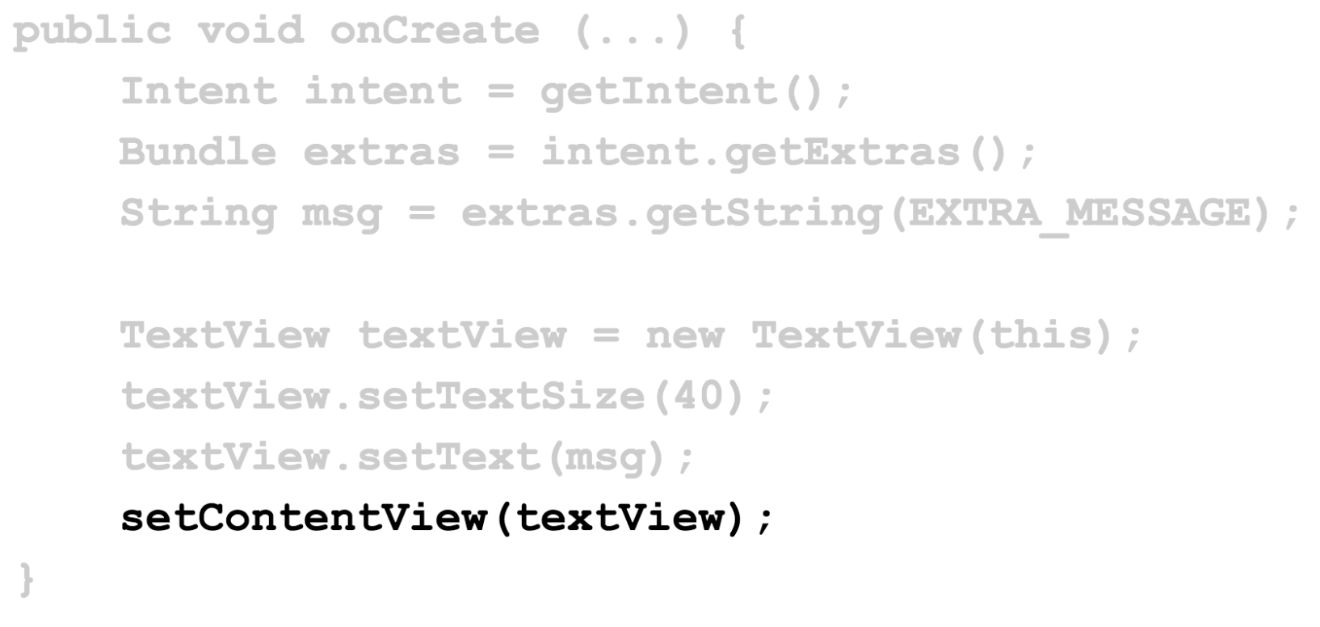

Slide 51

Coding time…

Slide 52
Intents – Your Turn (Again)
Add a string extra to the intent you created earlier
Read that string extra in the new activity, and display it on the screen.

Slide 53


Slide 54
Activity Lifecycle

Slide 55
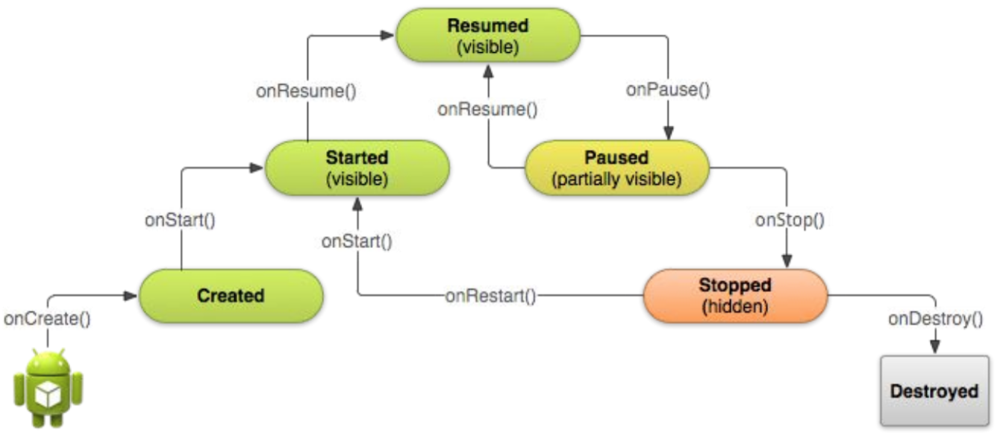
Activity Lifecycle - States
During its lifetime, an activity will move between several states.

Slide 56
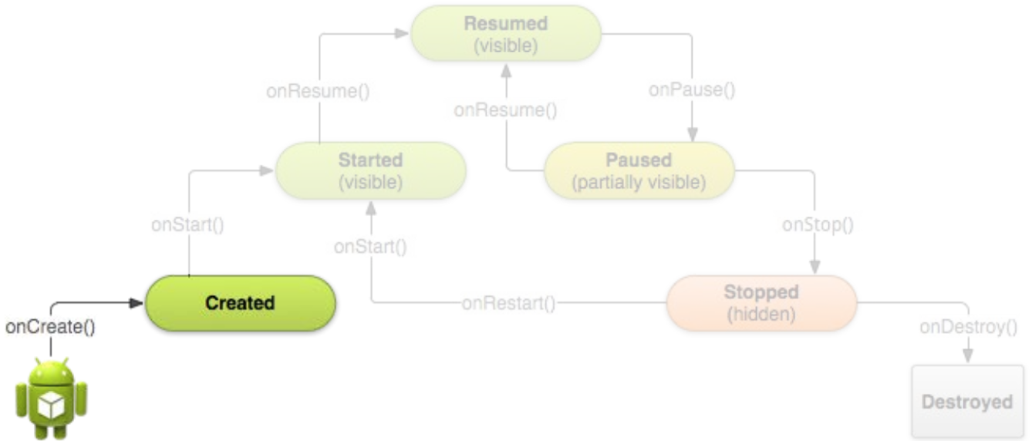
Activity Lifecycle – onCreate()
Called when the activity is first created. This is where you can create Views, setup data sources, etc. Always followed by onStart().

Slide 57
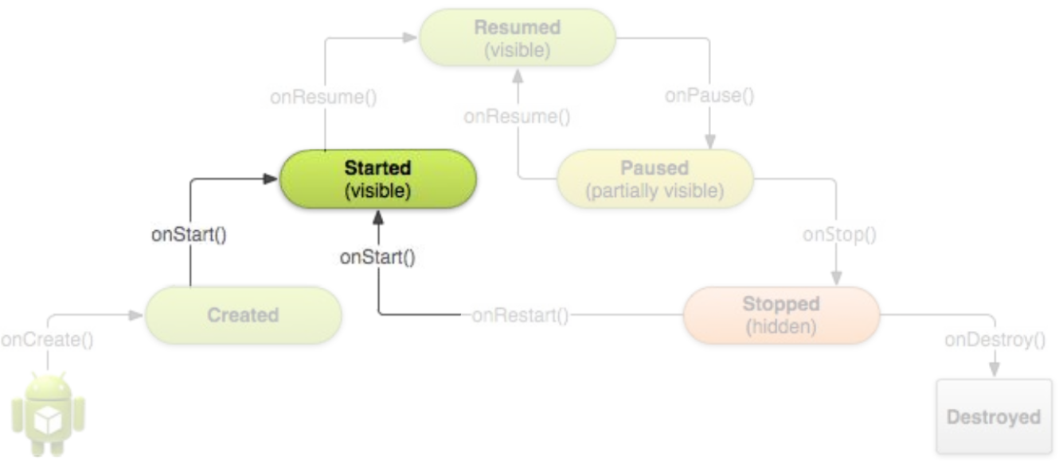
Activity Lifecycle – onStart()
The activity is becoming visible to the user. Always followed by onResume().

Slide 58
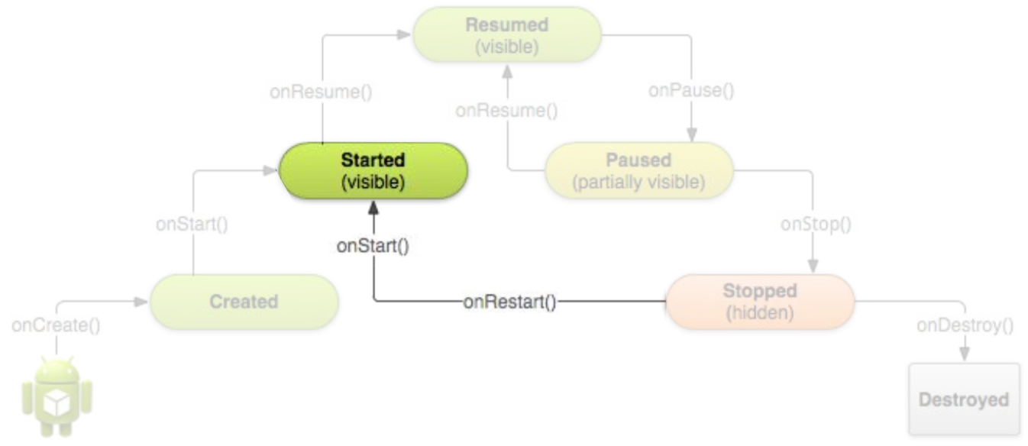
Activity Lifecycle – onRestart()
Called after the activity has been stopped, prior to it being started again. Always followed by onStart().

Slide 59
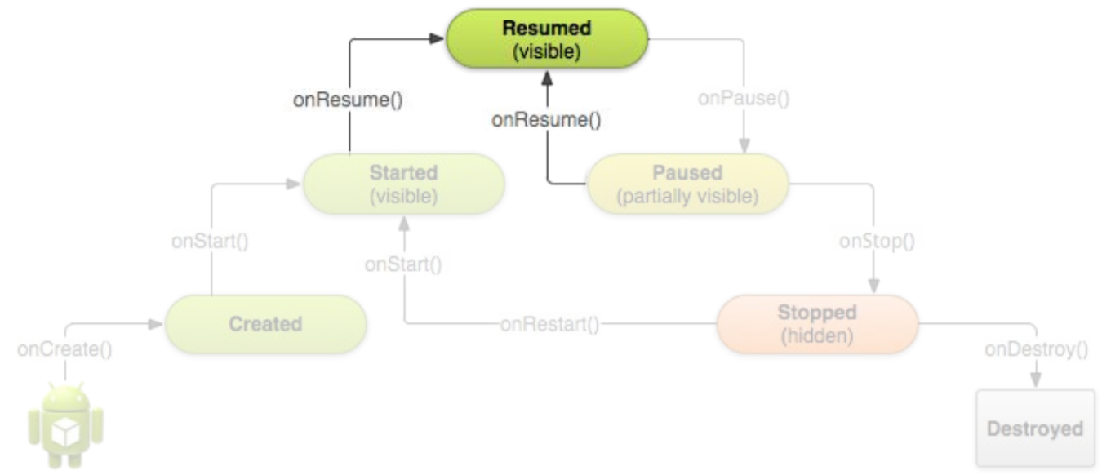
Activity Lifecycle – onResume()
Called when the activity will start interacting with the user. At this point, your activity is at the top of the stack and receiving user input.

Slide 60
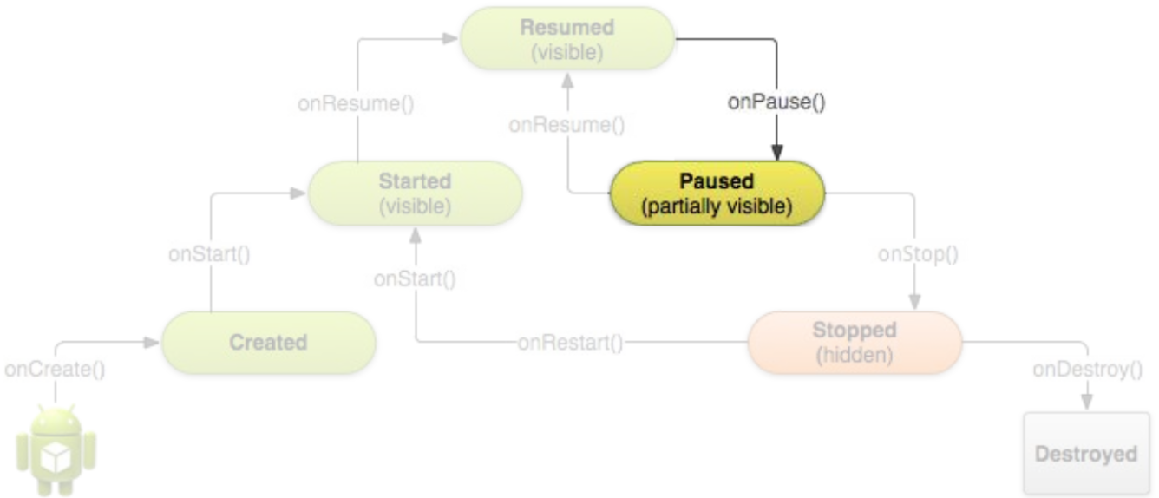
Activity Lifecycle – onPause()
Called when an activity is going into the background, but is not being killed yet (e.g. When a dialog pops up, another activity starts, etc.)
This is a counterpart to onResume().

Slide 61
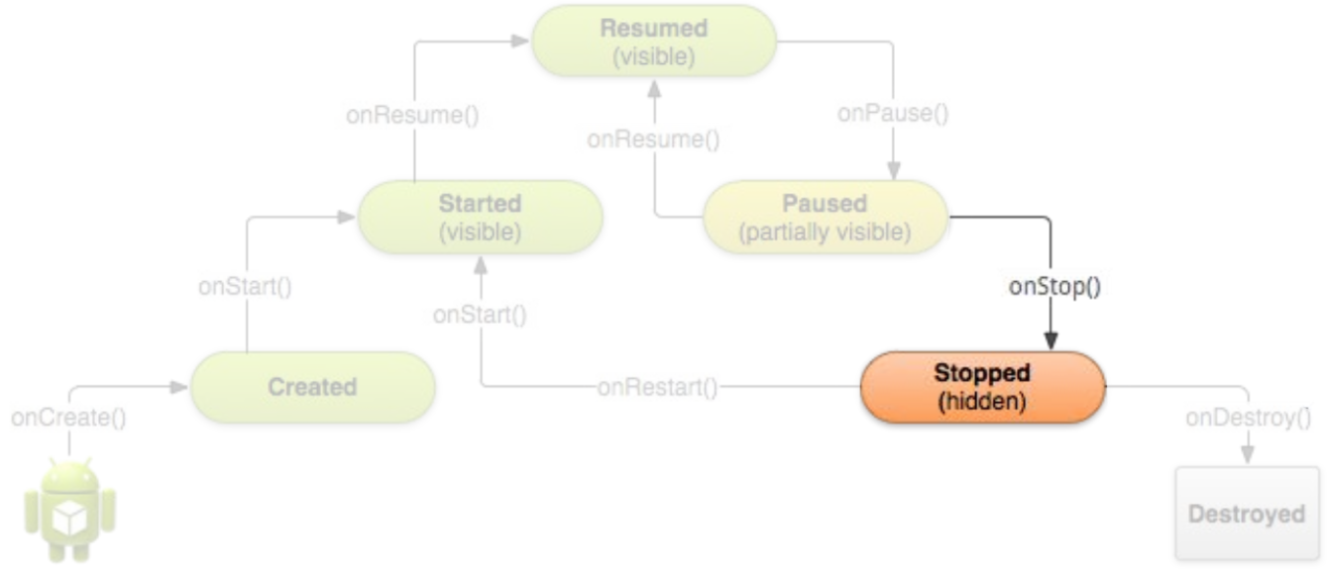
Activity Lifecycle – onStop()
Called when the activity is completely hidden from the user. Followed by onRestart() or onDestroy(), or sometimes nothing.

Slide 62
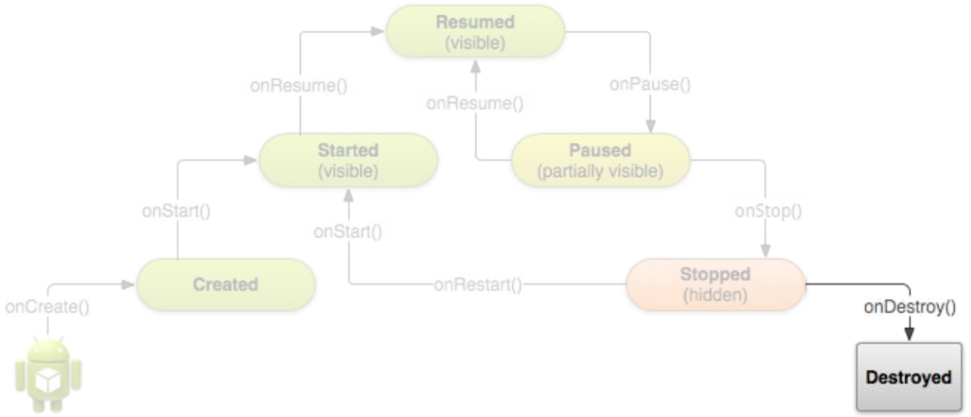
Activity Lifecycle – onDestroy()
Called when your activity is completely destroyed, either by the user fully exiting it or the system killing it to conserve resources.

Slide 63
Activity Lifecycle – Your Turn!
Create an activity (or use the same one) and set the view to be a single TextView as shown in the Intent section.
Add a line to this TextView each time one of the lifecycle methods is called
Ask if you need help!
Study how the methods are called, and in which order.

